Slide 1

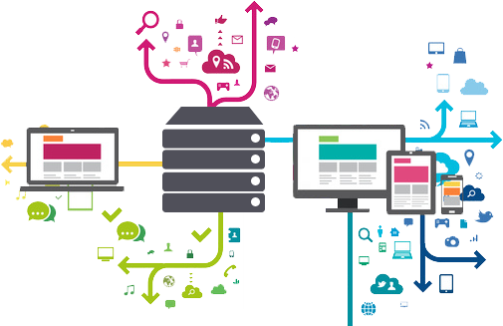

Docker
DevOps presentation
Titouan Fréville

Slide 2
Goals
Present Vagrant, Docker and CoreOS
Show how you can use it to ease development
Show you can use it to ease deployment
Make a simple example

Slide 3
Why should I use it ?
Have a stable environment between dev and prod
Be sure you will not break your own env when trying things
Work from everywhere :)

Slide 4

Create and configure lightweight, reproducible, and portable development environments.

Slide 5
Vagrant
Launch the whole platform in a single command line
Instant developer onboarding
Do it without annoying the Ops team

Slide 6
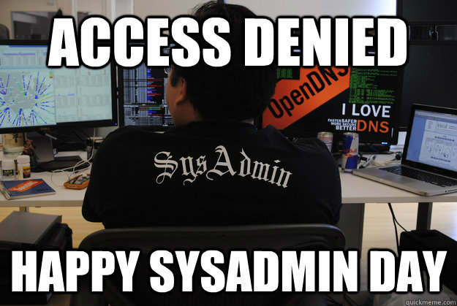
Notes:
Simple vagrant exemple

Slide 7
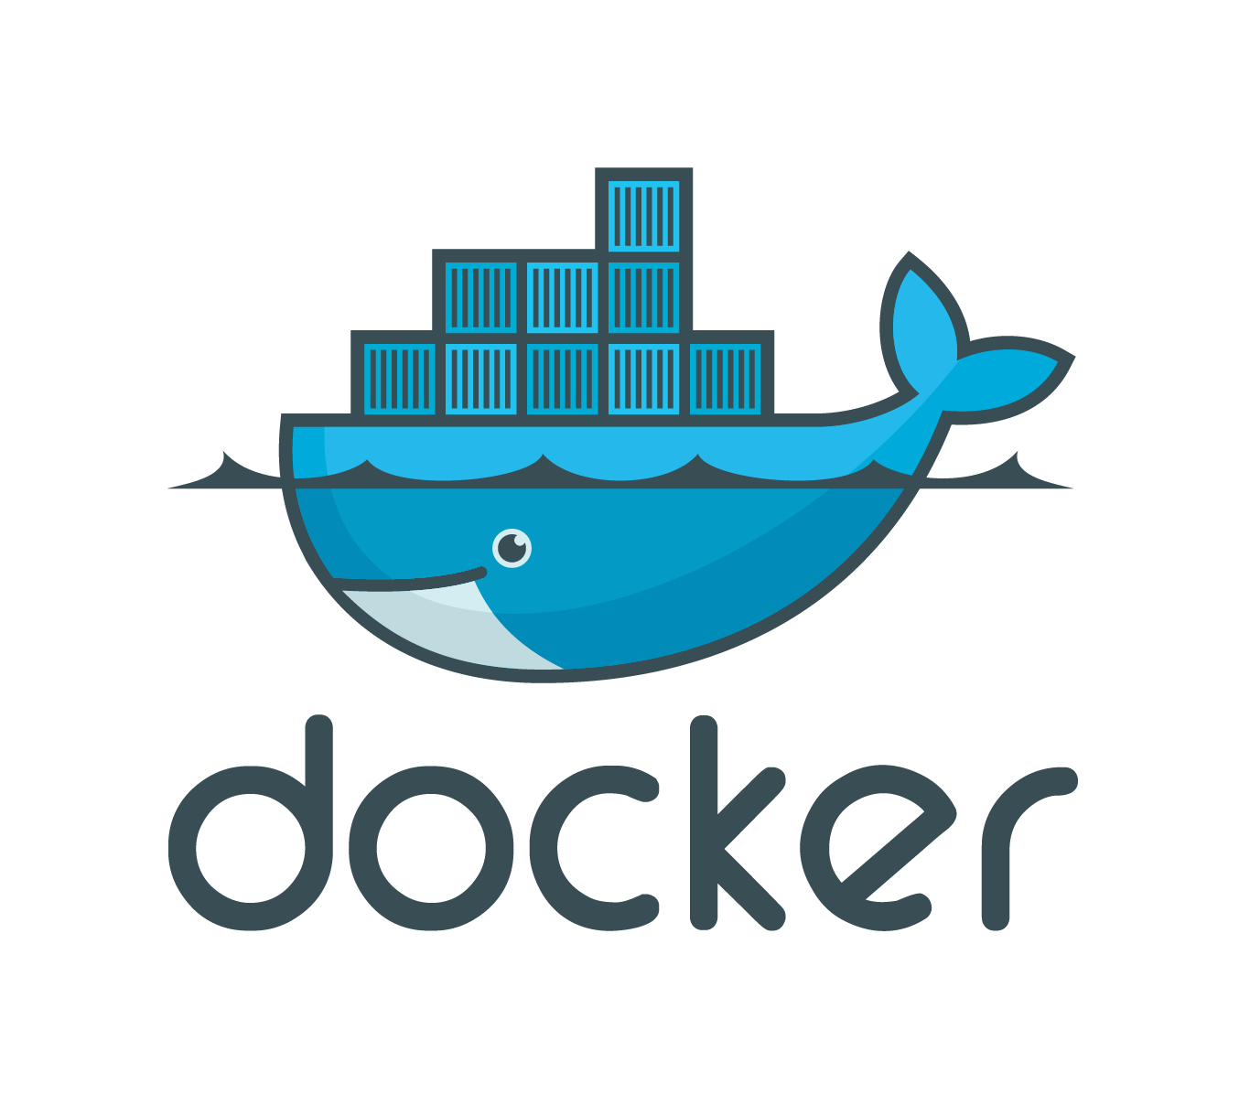
An open platform to build, ship and run any app, anywhere

Slide 8
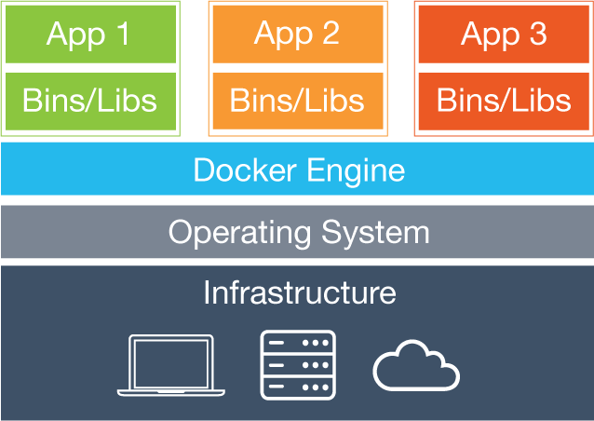
Why Docker ?
Isolation from the host OS
Pre-configuration
Easy shipping
Easy rollback
Easy tagging
Works everywhere

Slide 9


Slide 10
Why dockerize your dev env ?
Stabilize the environment between devs
Ease debug between dev
Make sure you can reproduce over dev issues

Slide 11
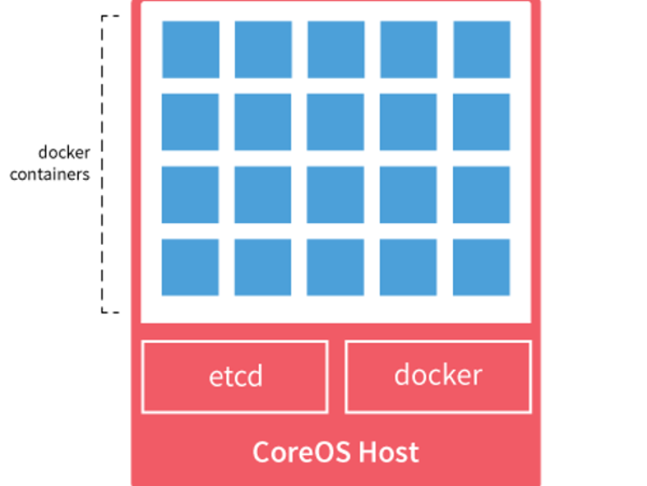
Why CoreOS
Built for running and managing containers in the cloud
Lighter OS than usual ones
Notes:
etcd is a distributed key value store that provides a reliable way to store data across a cluster of machines. It’s open-source and available on GitHub. etcd gracefully handles master elections during network partitions and will tolerate machine failure, including the master.
Your applications can read and write data into etcd. A simple use-case is to store database connection details or feature flags in etcd as key value pairs. These values can be watched, allowing your app to reconfigure itself when they change.
Advanced uses take advantage of the consistency guarantees to implement database master elections or do distributed locking across a cluster of workers.
core OS : 200 Mo

Slide 12
Use it to deploy application
Automate the deployment
Ease the debug process
Stabilise prod environment for cloud.

Slide 13
An example

Slide 14
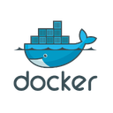
DB:x.x.x
MariaDB
Local env access
Redis
Elasticsearch
HHVM
Nginx
Web access
MailCatcher
AppStore:x.x.x
SSH Server
PhpStorm
Vagrant
Example of docker project organisation
link between dockers
access from outside the VM

Slide 15

Just wanted to test…

Slide 16
How to test
HHVM configure with
XDEBUG
Your favorite browser
PhpStorm
Appstore data
SSHFS
You can debug now
Vagrant

Slide 17
Developer onboarding
Hire developer (hardest task)
Give them a computer (without budget)
Install Vagrant
git clone … && vagrant up
Stack is up and running
Before: 3-4 days, after: 15 mins (room for more cat videos)
Notes:
Dockers on : redis, hhvm, data, elastisearch, web, install-dependencies, mariadb

Slide 18
Conclusion
What did we learn?

Slide 19



Slide 20

Thanks!
Titouan Freville
tfreville@nexway.com
217821@supinfo.com
@titouanfreville
https://fr.linkedin.com/pub/titouan-freville/9a/5b2/3

Slide 21
Play by yourself
Slides + exemple : https://github.com/titouanfreville/Docker_pres_SUPINFO/
Docs :
http://lmgtfy.com/?q=Docker+get+started
http://lmgtfy.com/?q=Vagrant+get+started

Slide 22
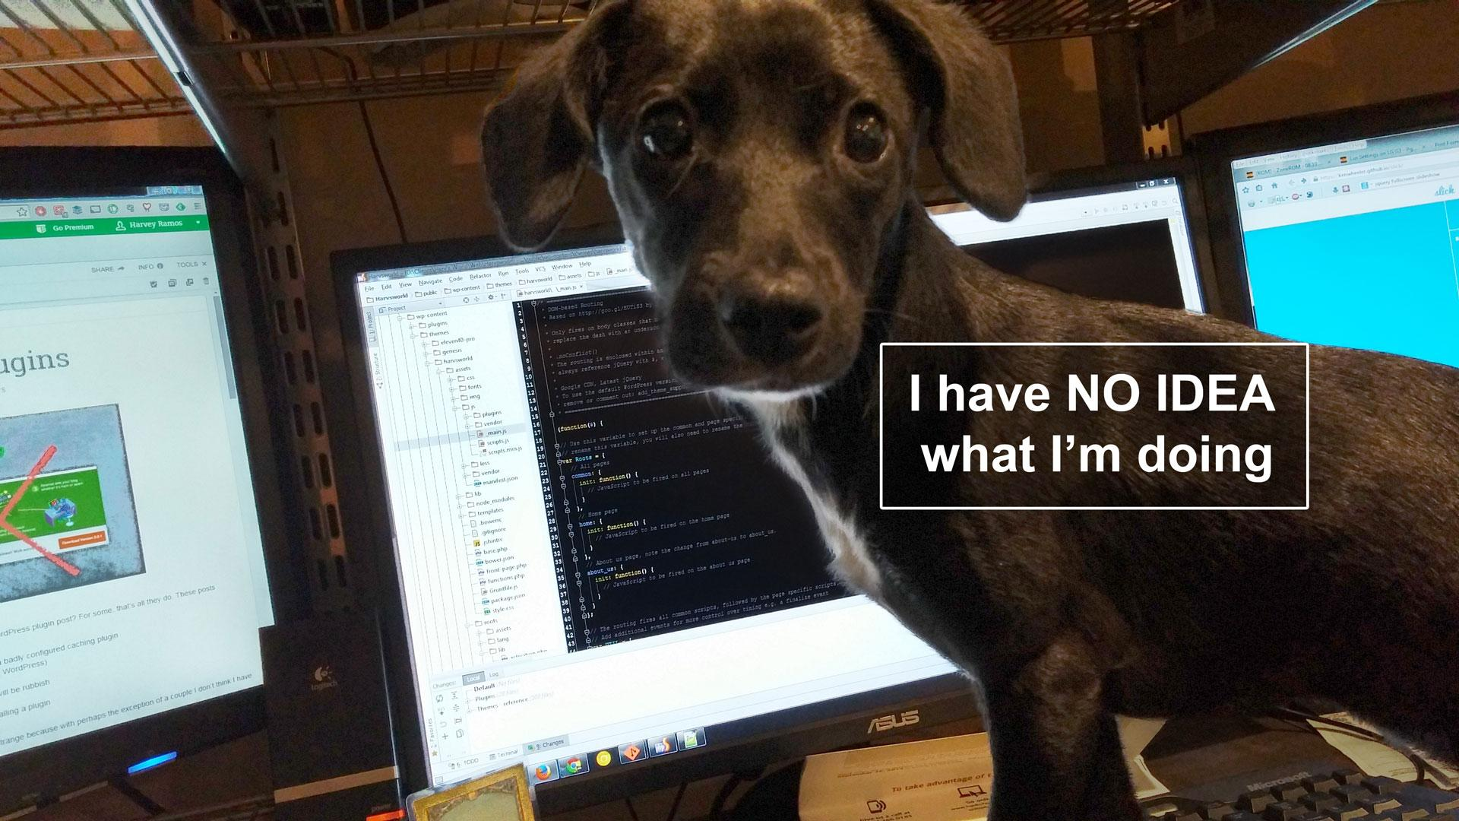
but I like it!

